Slide 1
analysis on mpg dataset gurpreet kaur 05/08/2025 saint peter’s university

Slide 2

Content
Introduction
Data preprocessing
Regression analysis
Residual Analysis
conclusion

Slide 3
Introduction Objective: To develop simple and multiple linear regression models to predict miles per gallon (MPG) based on various car features using the Auto MPG dataset. Observations: 398 car records Key Variables: mpg (target) horsepower weight acceleration cylinders origin Research Questions: Can we predict MPG accurately using a single feature like horsepower or weight? Does including more variables improve the model’s predictive power? Which model gives the best balance between accuracy and simplicity?

Slide 4
Data Preprocessing
Loaded data using readr::read_csv().
Handled missing values in 'horsepower' (converted to numeric).
Removed rows with NA values using na.omit().
Cleaned dataset exported as cleaned_auto_mpg.csv for Tableau.
Converted data types and selected first 300 rows for training.
Remaining used for testing and residual diagnostics

Slide 5
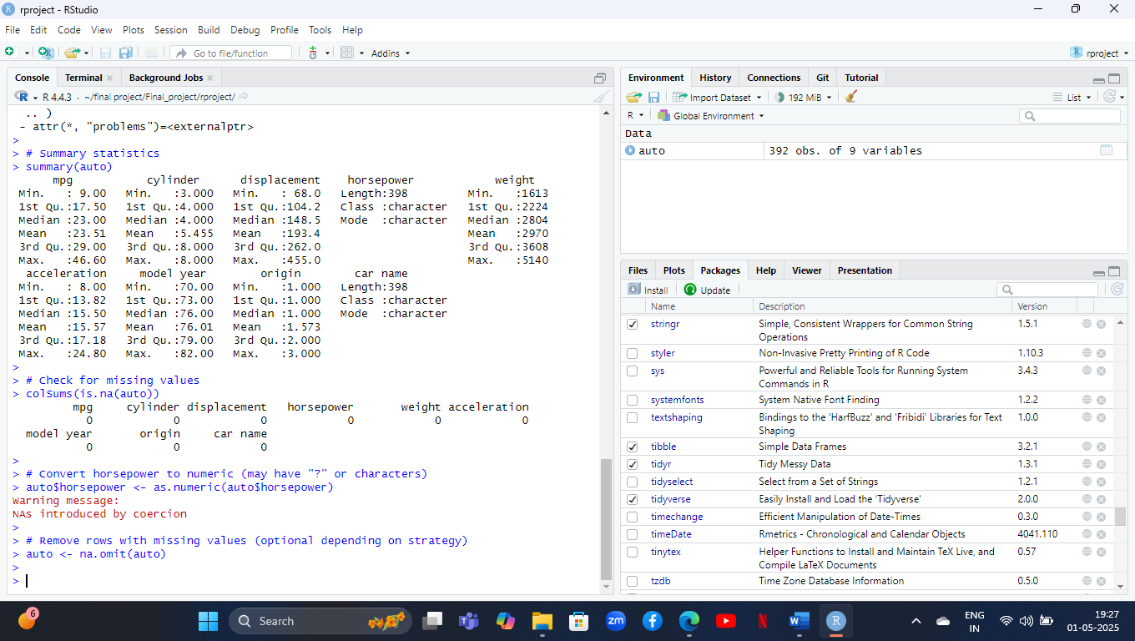
WHY CLEANING DATA ?
The horsepower column had values like "?", which are non-numeric strings.
These had to be converted to NA (missing values) and then removed or handled, because:
Regression models require numeric inputs.
Invalid entries would cause errors or biased results.
Columns like horsepower, weight, and acceleration needed to be converted to numeric types.
This ensures that mathematical operations and modeling work as expected.
Cleaning Data
Write a File cleaned_auto_mpg
Upload This File In Tableau

Slide 6
Simple Linear Regression Models
• mpg ~ horsepower
R² = 0.8577 | Adjusted R² = 0.8002
Equation: mpg = β₀ + β₁*horsepower = 23 +(-4.267)*horsepower
• mpg ~ weight
R² = 0.7741 | Adjusted R² = 0.7733
Equation: mpg = β₀ + β₁*weight = 40.388 + (-0.006)*weight
• mpg ~ cylinder
R² = 0.6716 | Adjusted R² = 0.6705
Equation: mpg = β₀ + β₁*cylinder = 37.878 + (-2.94)*cylinder
• Best single predictor: ‘horsepower' based on R² value.

Slide 7
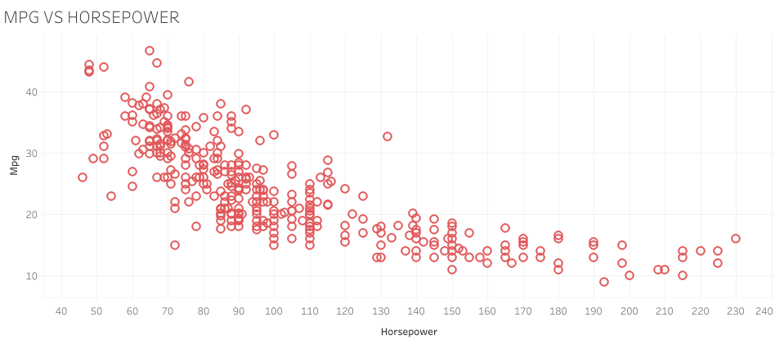
MPG VS HORSEPOWER
X-axis: Horsepower of vehicles.
Y-axis: Miles per Gallon (MPG), indicating fuel efficiency.
Each dot: Represents one vehicle.
As horsepower increases, MPG tends to decrease.
Vehicles with lower horsepower generally have higher fuel efficiency.
Vehicles with higher horsepower usually consume more fuel.

Slide 8
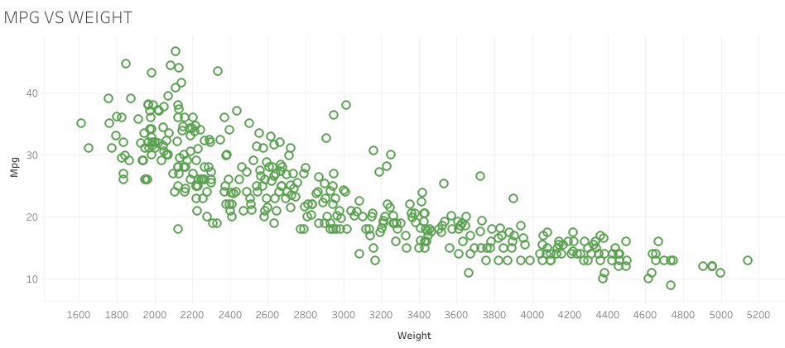
Mpg vs weight
X-axis: Vehicle Weight.
Y-axis: Miles per Gallon (MPG), indicating fuel efficiency.
Each dot: Represents one vehicle.
As vehicle weight increases, MPG decreases.
Heavier vehicles are generally less fuel efficient.
Lighter vehicles tend to have better fuel economy.

Slide 9
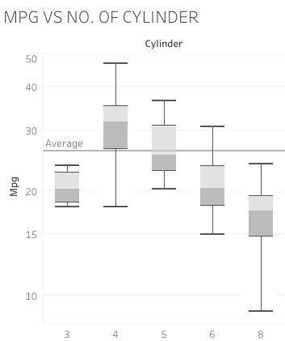
Mpg vs no. of cylinder
X-axis: Number of engine cylinders (3, 4, 5, 6, 8).
Y-axis: Miles per Gallon (MPG).
Box plot: Shows the distribution of MPG for each cylinder count.
MPG decreases as cylinder count increases.
Vehicles with 3–4 cylinders have higher MPG (more fuel-efficient).
6–8 cylinder vehicles have lower MPG (less fuel-efficient).
4-cylinder vehicles show the widest range and highest MPG median.
8-cylinder vehicles have the lowest median MPG and more variability.

Slide 10
Multiple Linear Regression Models
Three models with combinations of predictors:
• mpg ~ horsepower + weight + acceleration
R² = 0.8975 | Adjusted R² = 0.8547
Equation: mpg = b0 + b1*horsepower + b2*weight + b3*acceleration
= 34.937 + (-2.636)*horsepower + (-1.415)*weight + (-2.059)*acceleration
• mpg ~ horsepower + origin + acceleration
R² = 0.8975 | Adjusted R² = 0.8547
Equation: mpg = b0 + b1*horsepower + b2*weight + b3*acceleration
= 34.937 + (-2.636)*horsepower + (-1.415)*origin + (-2.059)*acceleration
• mpg ~ horsepower + cylinder + acceleration
R² = 0.8938 | Adjusted R² = 0.8002
Equation: mpg = b0 + b1*horsepower + b2*weight + b3*acceleration
= 38.472 + (-4.266)*horsepower + (-5.43)*cylinder + (-3.773)*acceleration

Slide 11
Residual Analysis
Residuals calculated from test set predictions.
Residual plot: Predicted MPG vs Residuals.
Histogram shows residuals are approximately normal.
Indicates model assumptions are reasonably met.

Slide 12
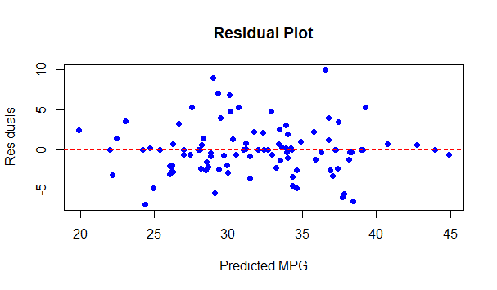
Mpg vs residual

Slide 13
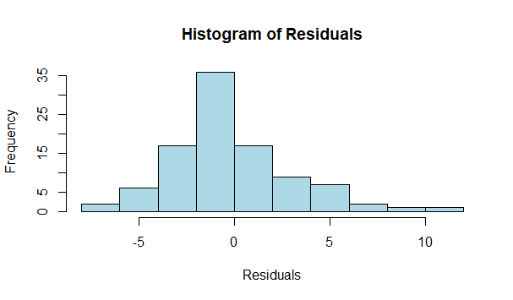

Slide 14
Conclusions
Best model: mpg ~ horsepower + weight + acceleration.
Residual diagnostics confirm good model fit.
Multiple regression significantly outperforms simple regression.
Weight and horsepower are key predictors.

